Slide 1
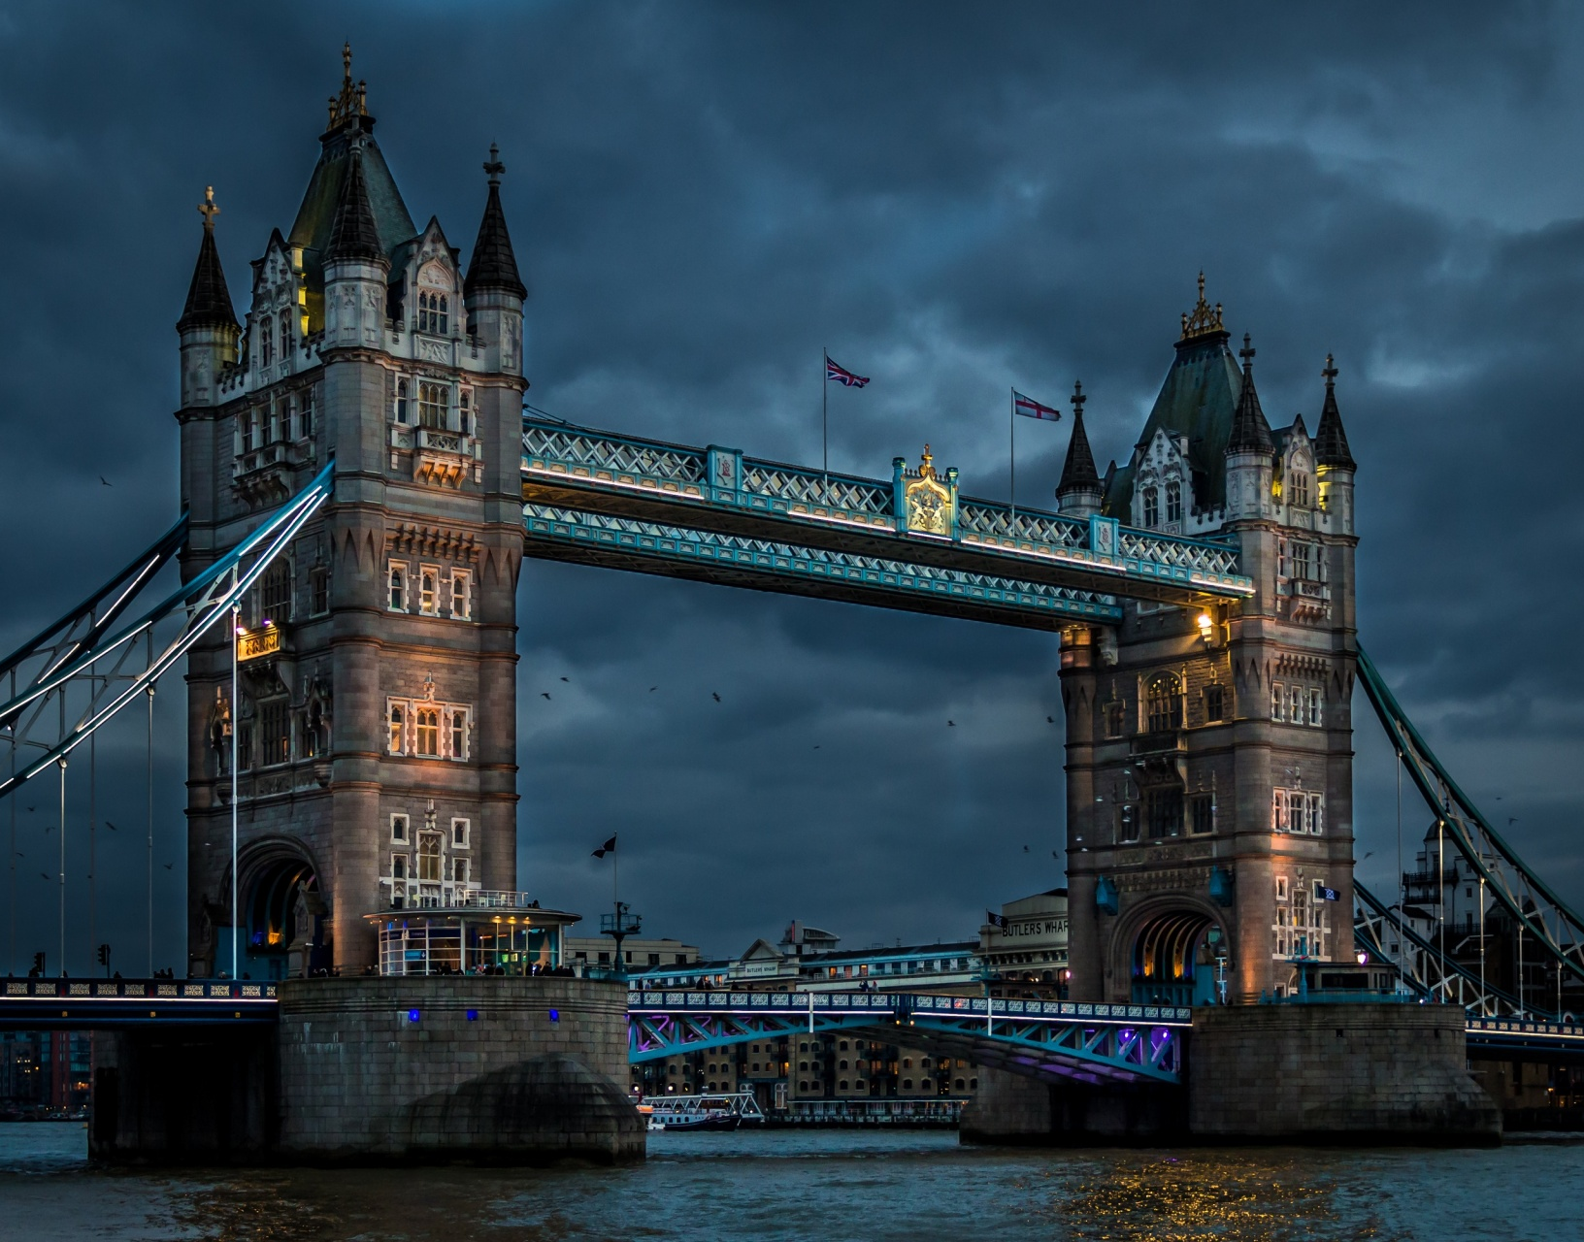
Dream Vacation Destination
UK, LONDON
SHAH HUNAIN

Slide 2
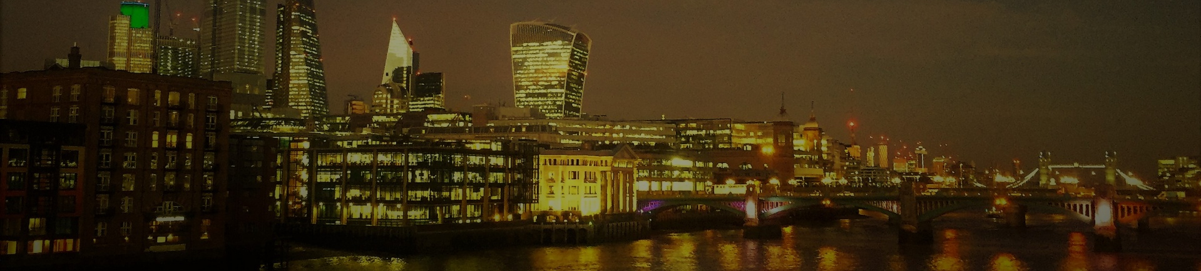
KNOW ABOUT LONDON
Largest urban area and capital city of the United Kingdom

Slide 3
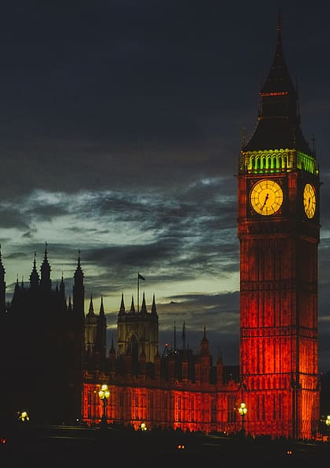
Geographical Features
Capital city of UK
Largest urban area
Located in South East of Great Britain
London is a port on the Thames, a
navigable river

Slide 4
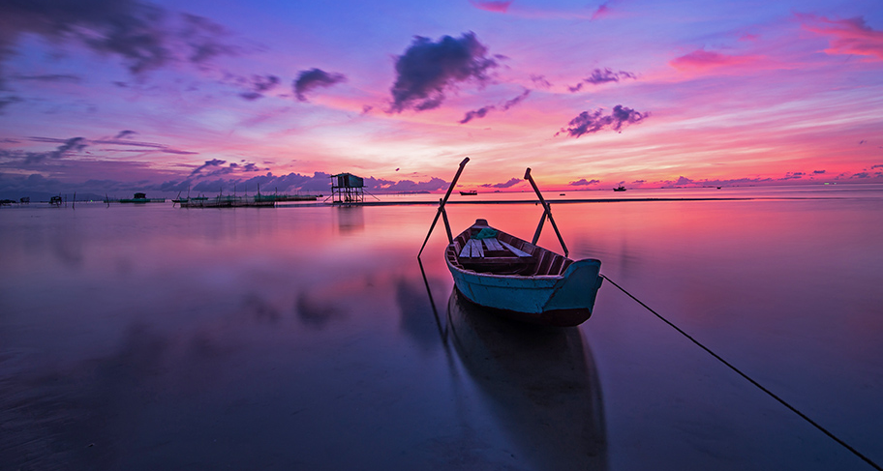
CLIMATE OF LONDON
Temperate Oceanic Climate
Also known as ‘Marine Climate’
Humid temperature climate sub-type
Summer is cold and winters are wild

Slide 5
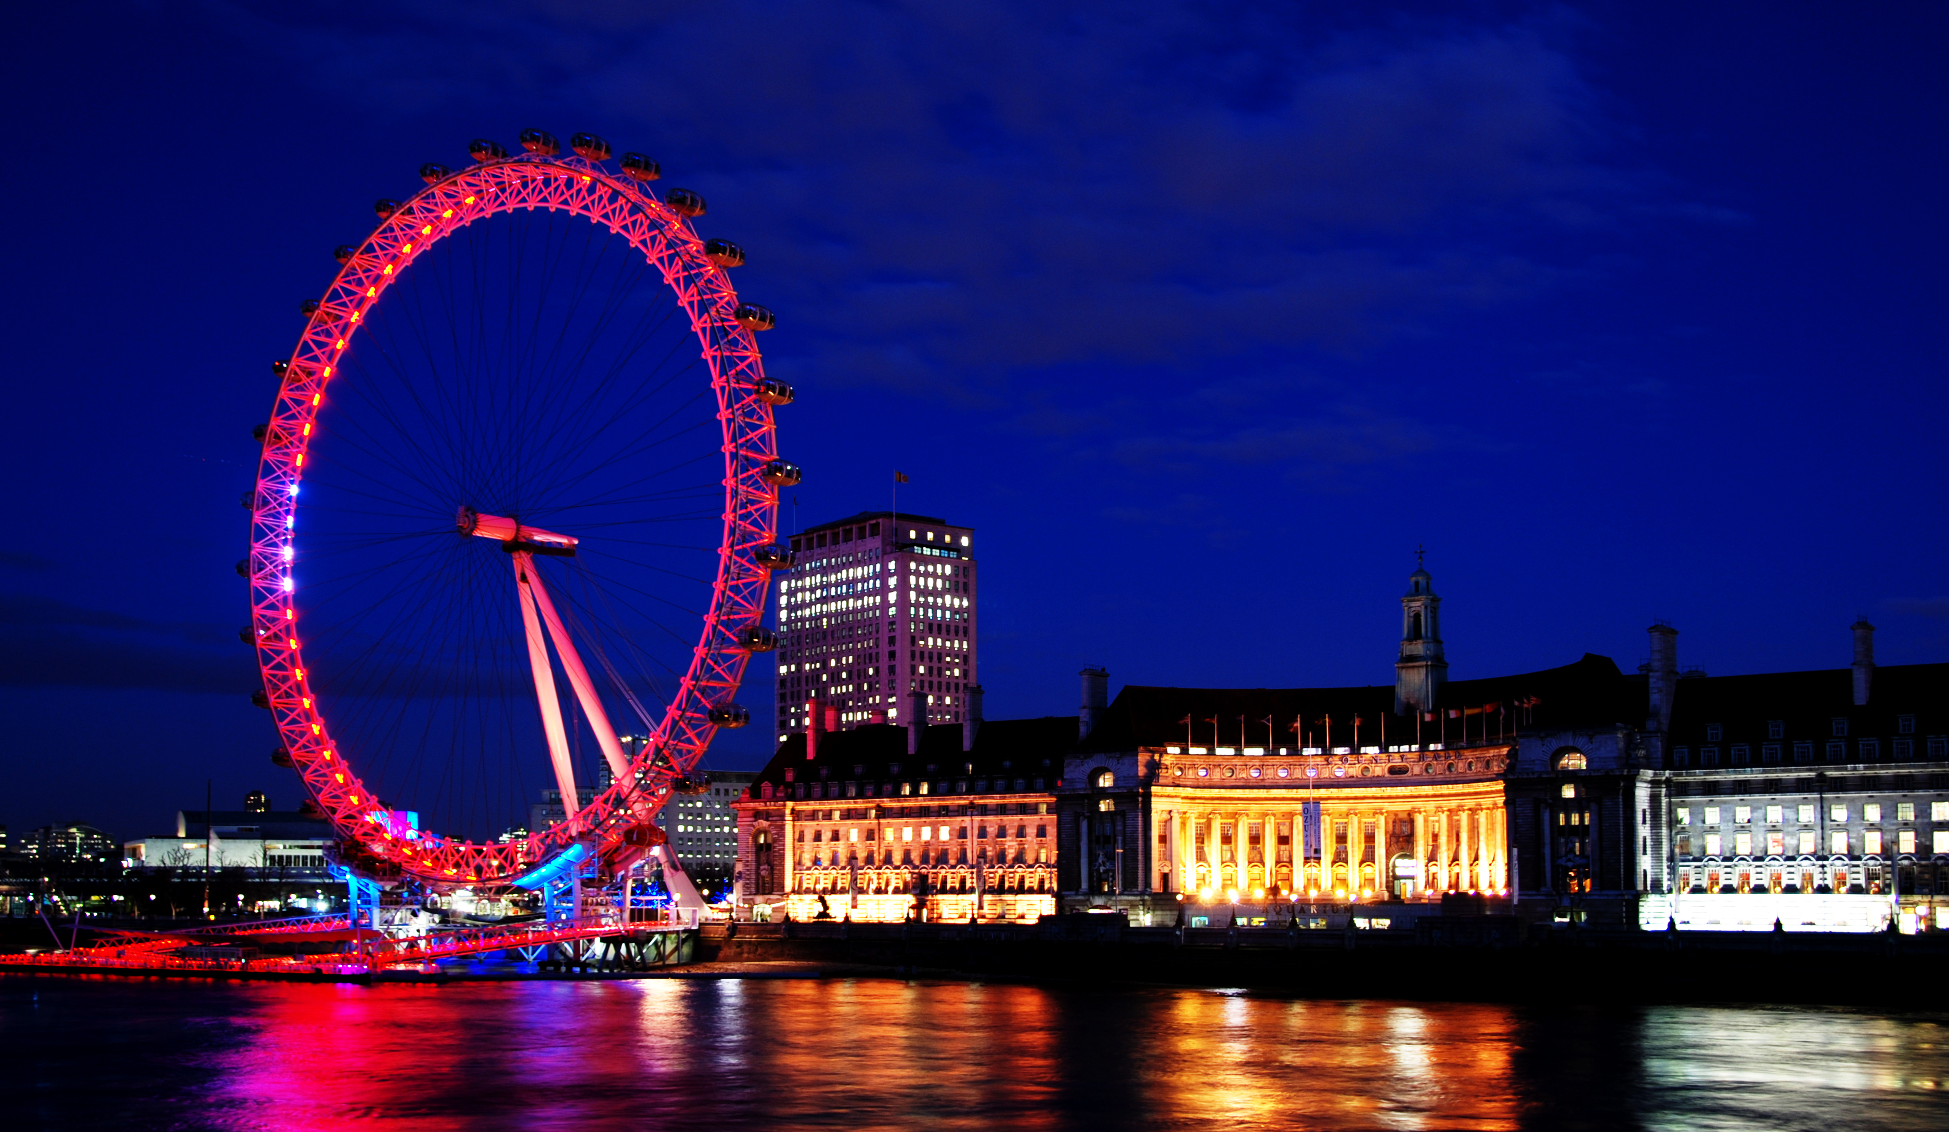
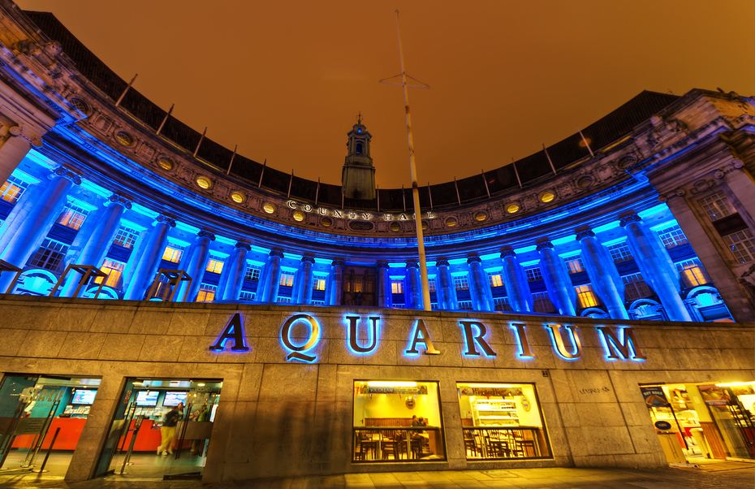
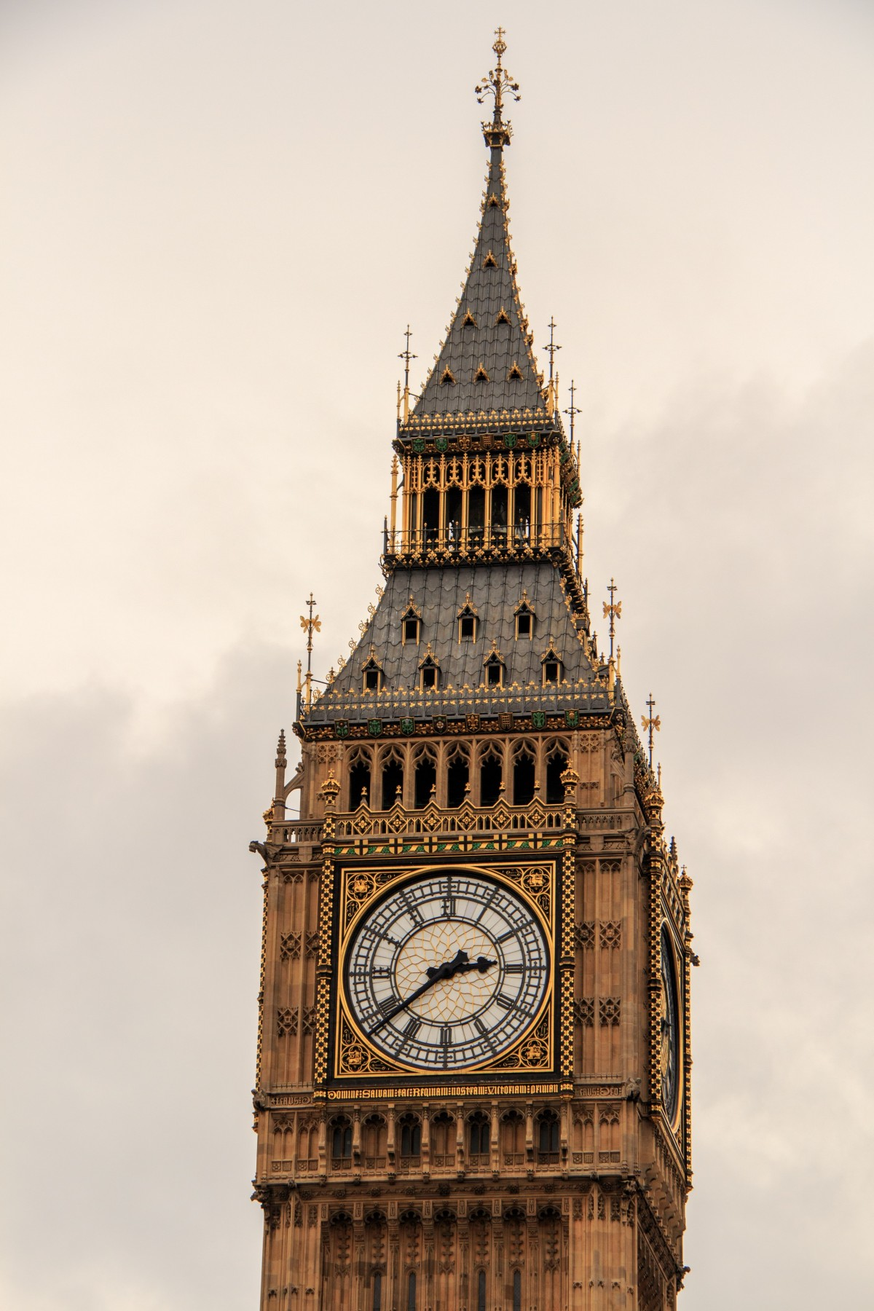
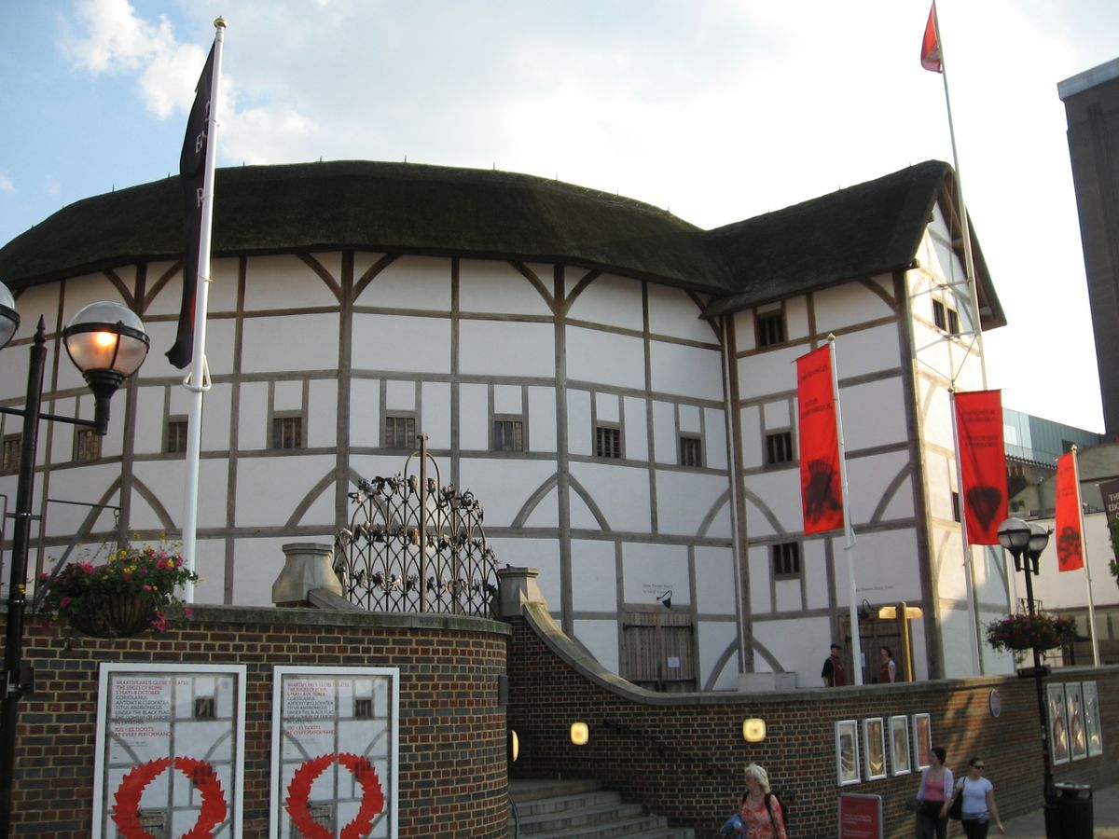
ACTIVITIES TO PERFORM
London includes various sort of exciting activities leading towards throughout fun
London Eye
Tower of London
Sea life
London Aquarium
Shakespeare's
Globe Theatre

Slide 6
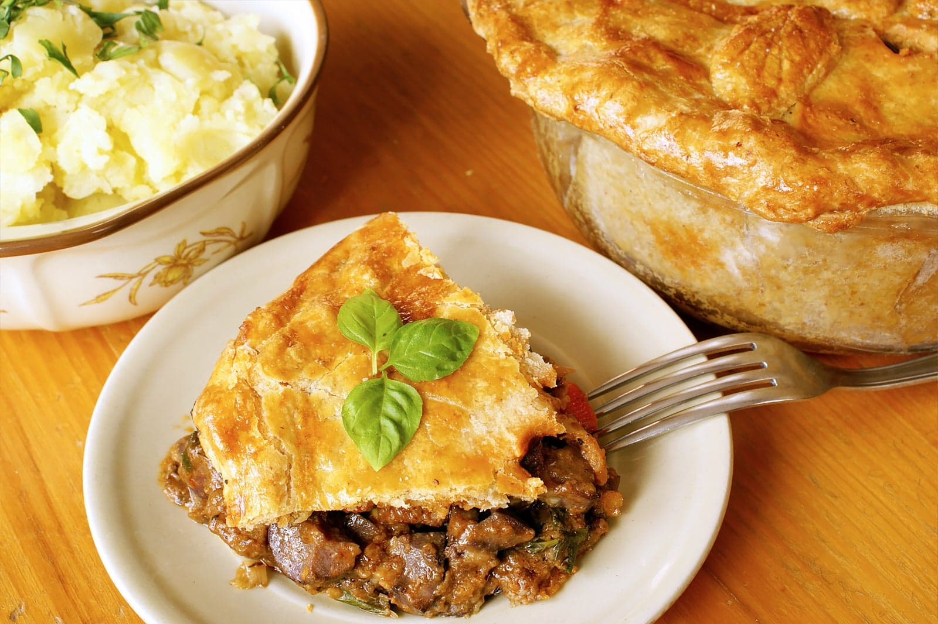
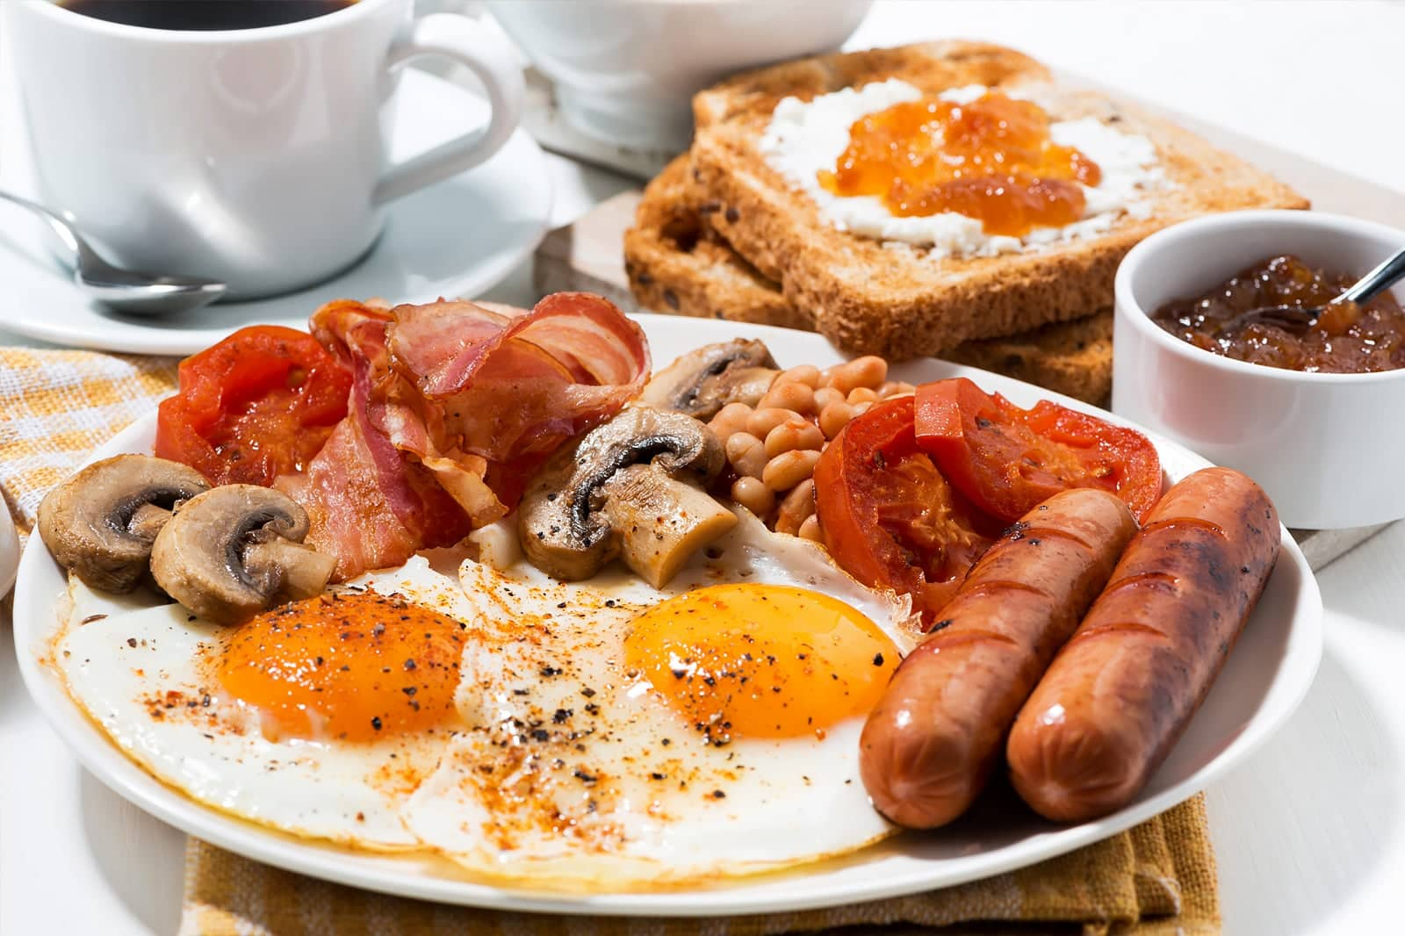
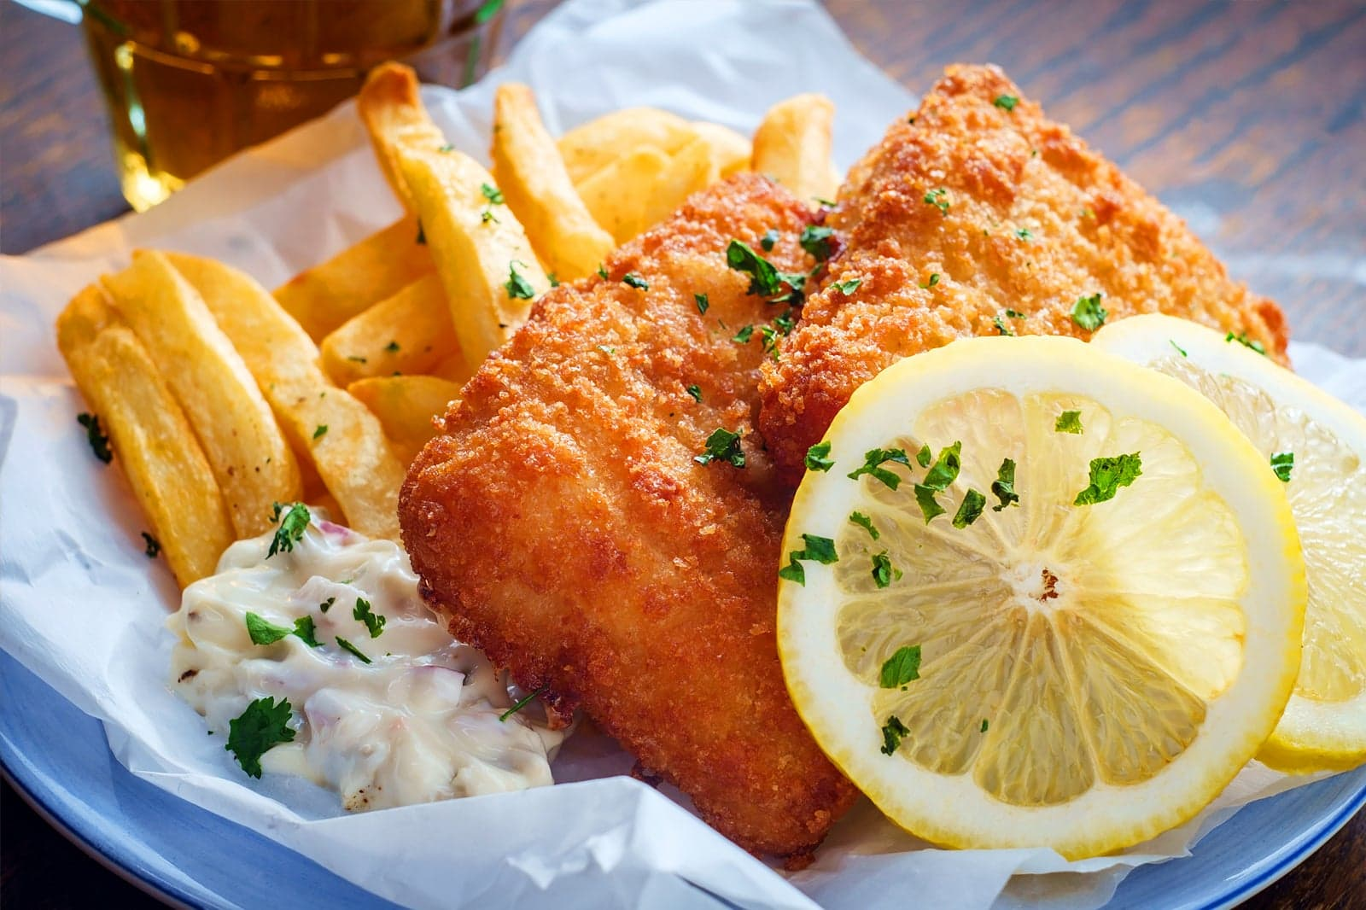
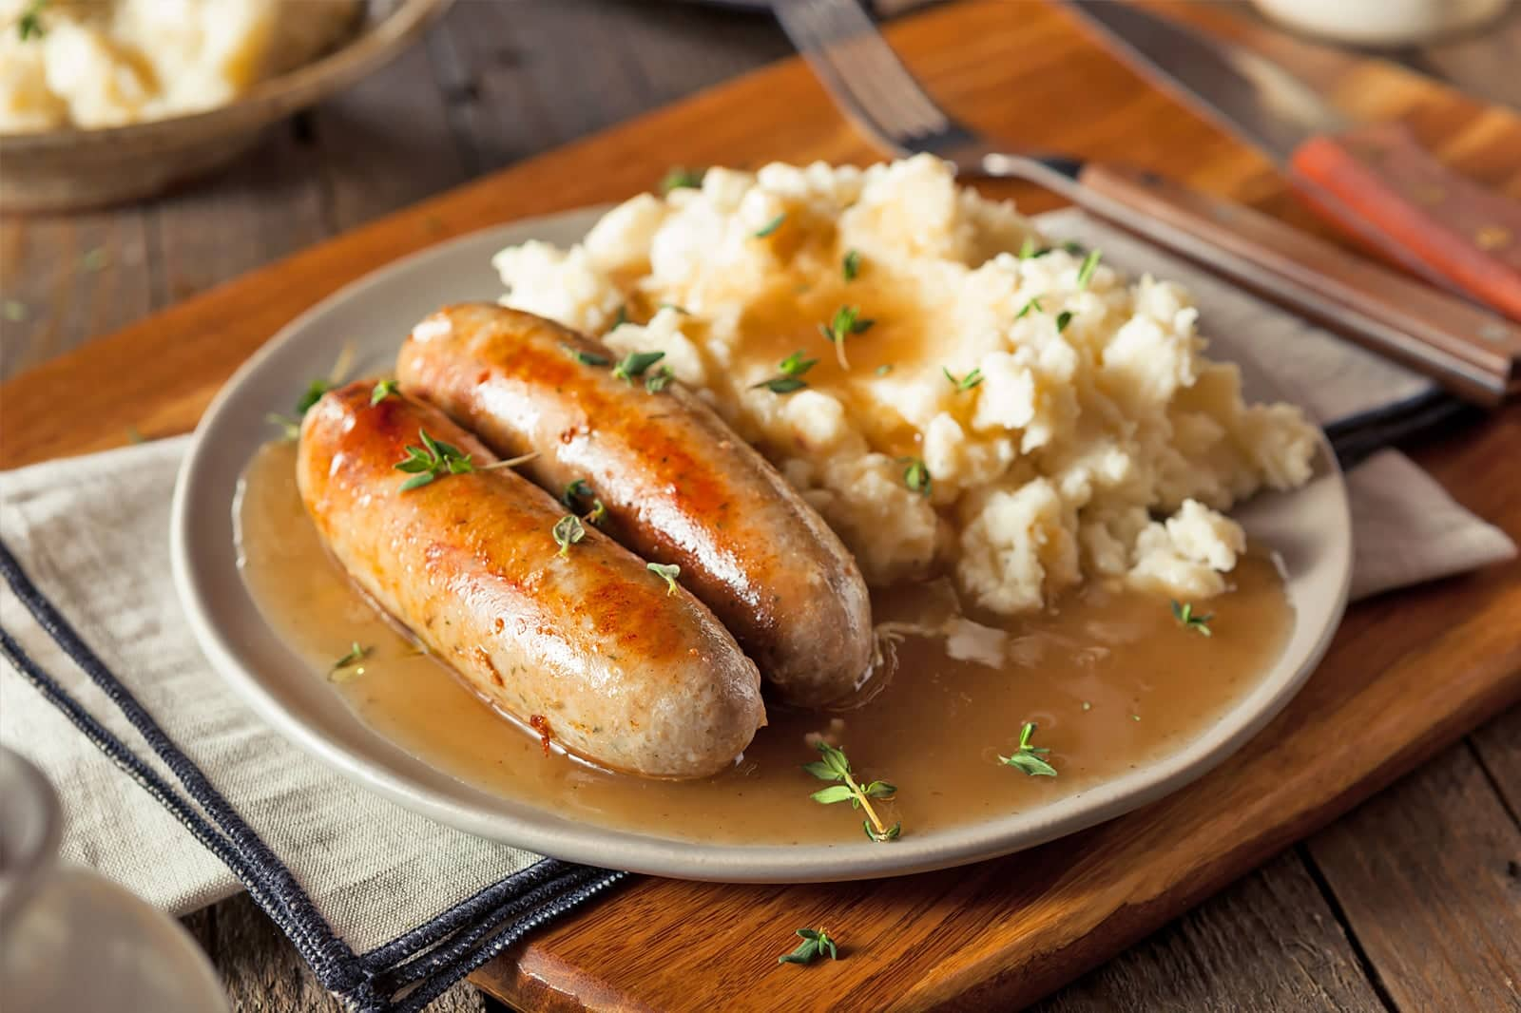
LOCAL CUISINE
FOOD TASTE MAKES LIFE WORTH SO
Steak and kidney pie
Traditional English breakfast
Sunday roast with Yorkshire pudding
Fish and chips
Afternoon tea
Bangers and mash

Slide 7
BUDGET
 | EXPECTED BUDGET (POUNDS) | ACTUAL BUDGET (POUNDS)
FLIGHT EXPENSE | 120,000 | 180,000
HOTEL STAY | 80,000 | 100,000
TRANSPORT | 8,000 | 9,000
EXPLORATION | 5,000 | 48,000
FOOD | 45,000 | 86,000
Estimated Budget
Breakdown For
The Trip

Slide 8
BUDGET BREAKDOWN
The expenses faced all through the trip
EXPECTED BUDGET
FINAL BUDGET

Slide 9
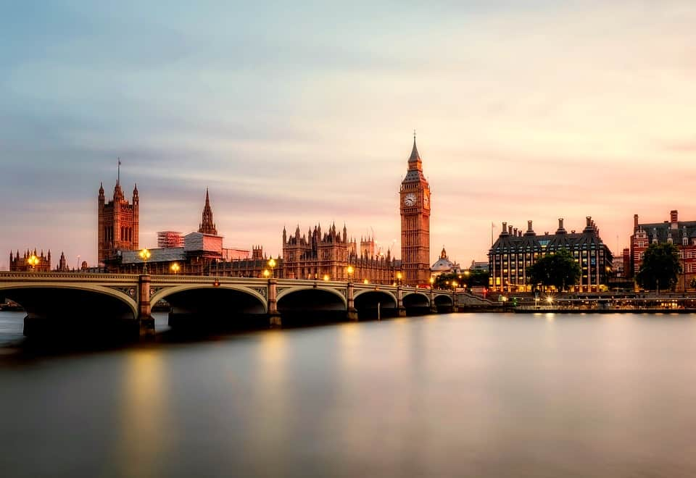
LONDON;UK
“A person who is tired of London is not necessarily tired of life; it might be that he just can't find a parking place.”

Slide 10
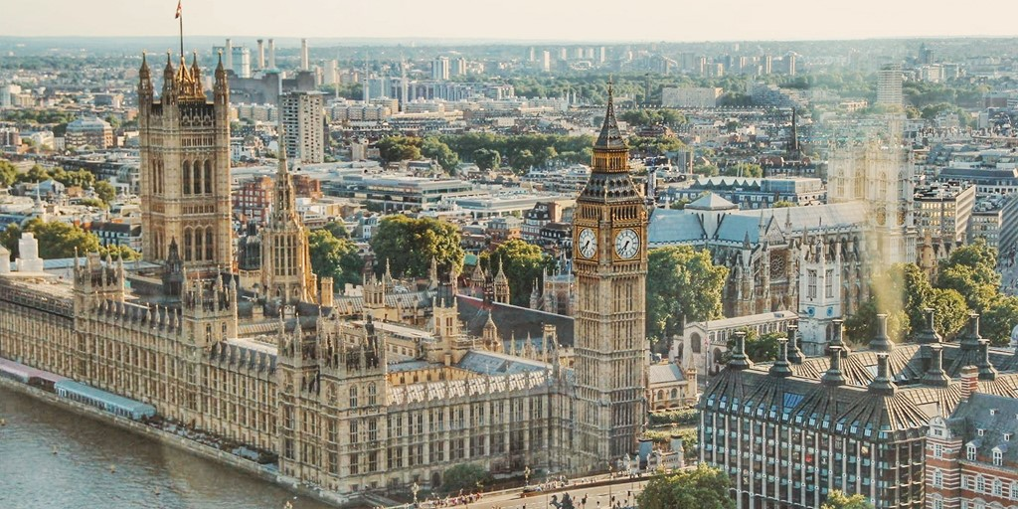
Why LONDON?
Filled with the places one would love to see
Great cuisine
A pleasure time
HOPES FOR THE TRIP:
Hope to declare it a best experience of my life
Full of amusement
A trip worth for everything

Slide 11

DREAM BIG
One should always think big because it all
depends upon our thinking. Everyone works up
to a particular set of mind if your thinking is not
vast and is bounded to a limit than you should
work on it and make it global. No doubt dreams
one day do come true.
Work on your dreams, dream big, plan about
your vacation destination and give your level
best to make it come true.

Slide 12
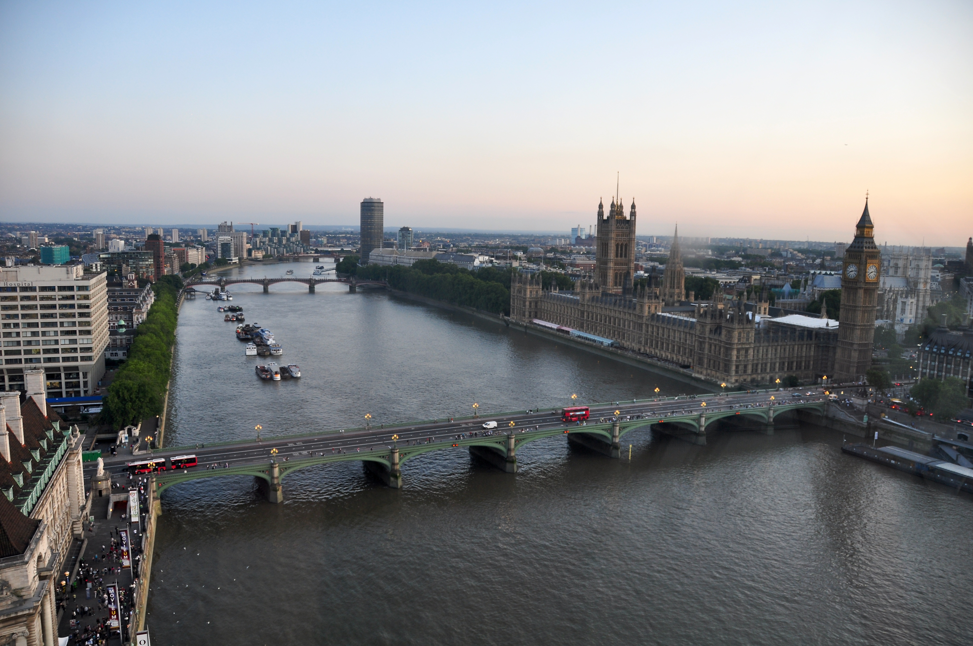
THANK YOU!
Shah Hunain
Section:
BSE-1A
Roll No:
23k-3032

